Slide 1
Functional Dependencies and Normalization

Slide 2
Content
Informal Design Guidelines for Relational Databases
  Semantics of the Relation Attributes
  Redundant Information in Tuples and Update Anomalies
  Null Values in Tuples
  Spurious Tuples
Functional Dependencies (FDs)
  Definition of FD
  Inference Rules for FDs
  Equivalence of Sets of FDs
  Minimal Sets of FDs
Functional Dependencies

Slide 3
Informal Design Guidelines for Relational Databases
What is relational database design?
The grouping of attributes to form "good" relation schemas
Two levels of relation schemas
  The logical "user view" level
  The storage "base relation" level
Design is concerned mainly with base relations
What are the criteria for "good" base relations?
Functional Dependencies

Slide 4
Informal Design Guidelines for Relational Databases
We first discuss informal guidelines for good relational design
Then we discuss formal concepts of functional dependencies and normal forms
1NF (First Normal Form)
2NF (Second Normal Form)
3NF (Third Normal Form)
BCNF (Boyce-Codd Normal Form)
Functional Dependencies

Slide 5
Semantics of the Relation Attributes
GUIDELINE 1: Informally, each tuple in a relation should represent one entity or relationship instance.
Attributes of different entities (EMPLOYEEs, DEPARTMENTs, PROJECTs) should not be mixed in the same relation
Only foreign keys should be used to refer to other entities
Entity and relationship attributes should be kept apart as much as possible.
Functional Dependencies

Slide 6
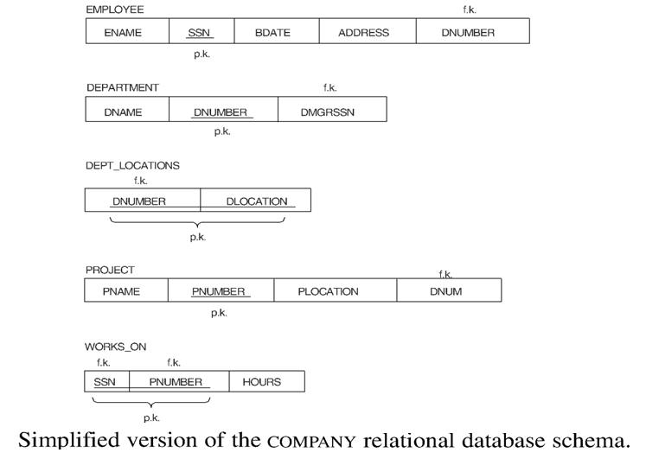
Functional Dependencies

Slide 7
Redundant Information in Tuples and Update Anomalies
Mixing attributes of multiple entities may cause problems
Information is stored redundantly wasting storage
Problems with update anomalies
  Insertion anomalies
  Deletion anomalies
  Modification anomalies
Functional Dependencies

Slide 8
EXAMPLE OF AN UPDATE ANOMALY (1)
Consider the relation:
EMP_PROJ ( Emp#, Proj#, Ename, Pname, No_hours)
Update Anomaly: Changing the name of project number P1 from “Billing” to “Customer-Accounting” may cause this update to be made for all 100 employees working on project P1.
Functional Dependencies

Slide 9
EXAMPLE OF AN UPDATE ANOMALY
Insert Anomaly: Cannot insert a project unless an employee is assigned to .
Inversely - Cannot insert an employee unless he is assigned to a project.
Delete Anomaly: When a project is deleted, it will result in deleting all the employees who work on that project. Alternately, if an employee is the sole employee on a project, deleting that employee would result in deleting the corresponding project.
Functional Dependencies

Slide 10
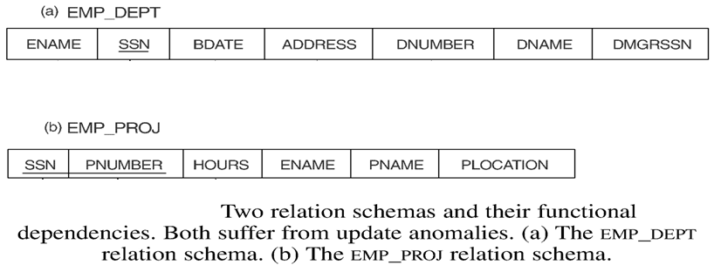
Functional Dependencies

Slide 11
Guideline to Redundant Information in Tuples and Update Anomalies
GUIDELINE 2: Design a schema that does not suffer from the insertion, deletion and update anomalies. If there are any present, then note them so that applications can be made to take them into account
Functional Dependencies

Slide 12
Null Values in Tuples
GUIDELINE 3: Relations should be designed such that their tuples will have as few NULL values as possible
Attributes that are NULL frequently could be placed in separate relations (with the primary key)
Functional Dependencies

Slide 13
Spurious Tuples
Bad designs for a relational database may result in erroneous results for certain JOIN operations
The "lossless join" property is used to guarantee meaningful results for join operations
GUIDELINE 4: The relations should be designed to satisfy the lossless join condition. No spurious tuples should be generated by doing a natural-join of any relations.
Functional Dependencies

Slide 14
Spurious Tuples (2)
There are two important properties of decompositions:
non-additive or losslessness of the corresponding join
preservation of the functional dependencies.
Note that :
Property (a) is extremely important and cannot be sacrificed.
Property (b) is less stringent and may be sacrificed.
Functional Dependencies

Slide 15
Functional Dependencies (1)
Functional dependencies (FDs) are used to specify formal measures of the "goodness" of relational designs
FDs and keys are used to define normal forms for relations
FDs are constraints that are derived from the meaning and interrelationships of the data attributes
Functional Dependencies

Slide 16
Functional Dependencies (2)
A set of attributes X functionally determines a set of attributes Y if the value of X determines a unique value for Y
X ➔ Y holds if whenever two tuples have the same value for X, they must have the same value for Y
For any two tuples t1 and t2 in any relation instance r(R): If t1[X]=t2[X], then t1[Y]=t2[Y]
Functional Dependencies

Slide 17
Functional Dependencies (2)
X ➔ Y in R specifies a constraint on all relation instances r(R)
Written as X ➔ Y; can be displayed graphically on a relation schema as in Figures. ( denoted by the arrow: ).
FDs are derived from the real-world constraints on the attributes
Functional Dependencies

Slide 18
Functional Dependencies (2)
An FD is a property of the attributes in the schema R
The constraint must hold on every relation instance r(R)
If K is a key of R, then K functionally determines all attributes in R (since we never have two distinct tuples with t1[K]=t2[K])
Functional Dependencies

Slide 19
Examples of FD constraints
social security number determines employee name
SSN ➔ ENAME
project number determines project name and location
PNUMBER ➔ {PNAME, PLOCATION}
employee ssn and project number determines the hours per week that the employee works on the project
{SSN, PNUMBER} ➔ HOURS
Functional Dependencies

Slide 20
Inference Rules for FDs (1)
Given a set of FDs F, we can infer additional FDs that hold whenever the FDs in F hold
Armstrong's inference rules:
IR1. (Reflexive) If Y subset-of X, then X ➔ Y
IR2. (Augmentation) If X ➔ Y, then XZ ➔ YZ
(Notation: XZ stands for X U Z)
IR3. (Transitive) If X ➔ Y and Y ➔ Z, then X ➔ Z
IR1, IR2, IR3 form a sound and complete set of inference rules
Functional Dependencies

Slide 21
Inference Rules for FDs (2)
Some additional inference rules that are useful (deduced from IR1, IR2, and IR3 ):
(Decomposition) If X ➔ YZ, then X ➔ Y and X ➔ Z
(Union) If X ➔ Y and X ➔ Z, then X ➔ YZ
(Psuedotransitivity)
If X ➔ Y and WY ➔ Z, then WX ➔ Z
Functional Dependencies

Slide 22
Inference Rules for FDs (3)
Closure of a set F of FDs is the set F⁺ of all FDs that can be inferred from F
Closure of a set of attributes X with respect to F is the set X⁺ of all attributes that are functionally determined by X
X⁺ can be calculated by repeatedly applying IR1, IR2, IR3 using the FDs in F
Functional Dependencies

Slide 23
Equivalence of Sets of FDs
Two sets of FDs F and G are equivalent if:
- every FD in F can be inferred from G, and
- every FD in G can be inferred from F
Hence, F and G are equivalent if F ⁺ =G ⁺
Definition: F covers G if every FD in G can be inferred from F (i.e., if G ⁺ subset-of F ⁺)
F and G are equivalent if F covers G and G covers F
There is an algorithm for checking equivalence of sets of FDs
Functional Dependencies

Slide 24
Minimal Sets of FDs (1)
A set of FDs is minimal if it satisfies the following conditions:
Every dependency in F has a single attribute for its RHS.
We cannot remove any dependency from F and have a set of dependencies that is equivalent to F.
We cannot replace any dependency X ➔ A in F with a dependency Y ➔ A, where Y proper-subset-of X ( Y subset-of X) and still have a set of dependencies that is equivalent to F.
Functional Dependencies

Slide 25
Minimal Sets of FDs (2)
Every set of FDs has an equivalent minimal set
There can be several equivalent minimal sets
There is no simple algorithm for computing a minimal set of FDs that is equivalent to a set F of FDs
To synthesize a set of relations, we assume that we start with a set of dependencies that is a minimal set
Functional Dependencies

